Slide 1

Signal Processing Project
Team: DeNoicifiers

Slide 2
Contents:
Part 1 - Echo Creation: Convolution with shifted and Scaled Kronecker Deltas
01
Part 2 - Cancel the Echo: NLMS Method of Adaptive FIR Filters
02
Part 3 - What is the Noise?: STFT based approach
03

Slide 3
Part 1 - Echo creation
An Echo is just the sum of the Original signal and the Delayed, attenuated signal received after reflection from an obstacle.
To produce an Echo, we need to Delay it by certain time and attenuate it.
Any number of echos can be created until the sound gets completely attenuated
The Below Diagrams give us an idea of implementation of Echo Creation:

Slide 4
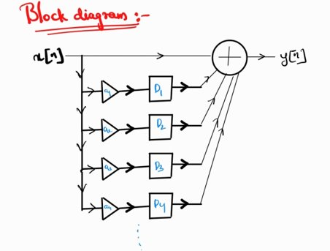
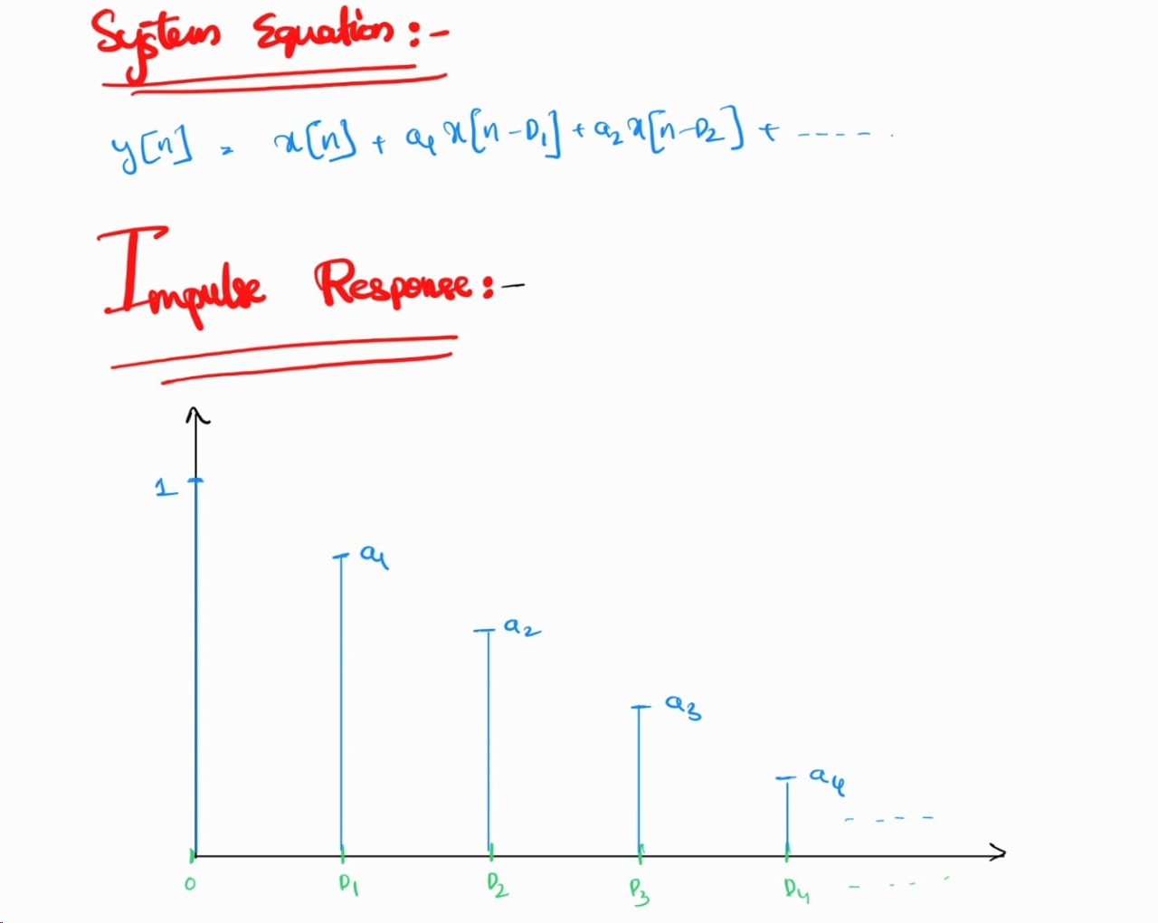
Part 1 - Echo creation

Slide 5
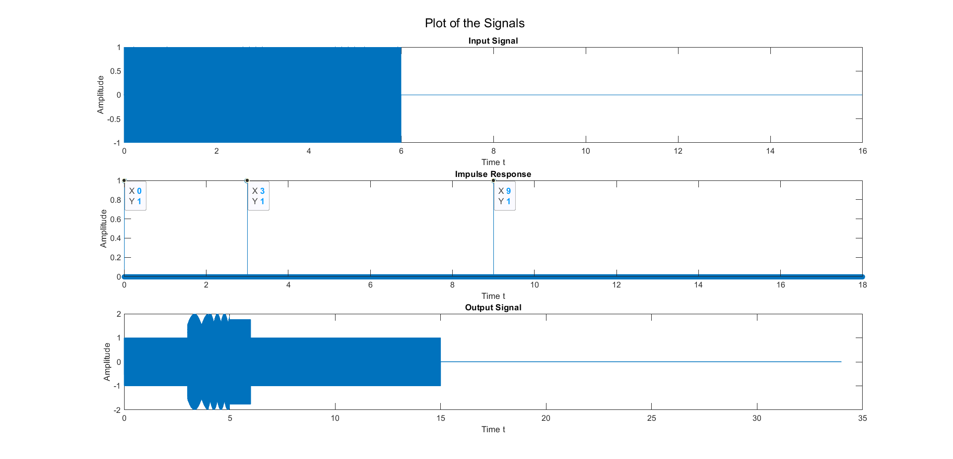
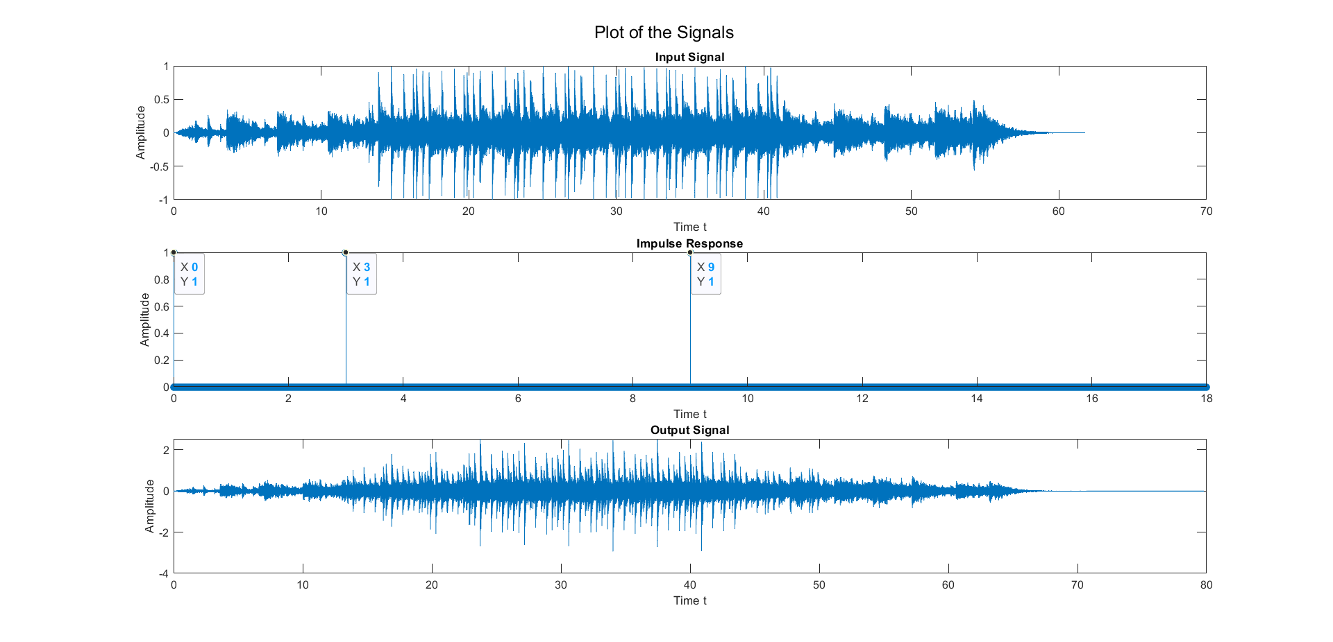
Part 1 - Echo creation: Output Plots

Slide 6

Output for Part 1:
For q1.wav: For q1_hard.wav:
Input:
Output:

Slide 7
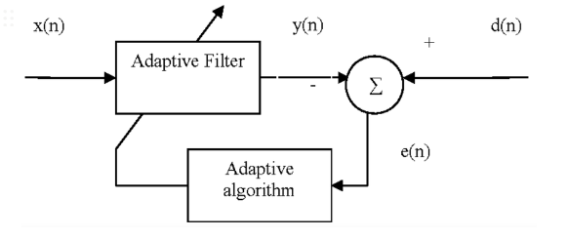
Part 2 - Cancel the echo
1. Filter Output: y(k) = w^H x(k)
2. Estimated Error: e(k) = d(k) − y(k)
3. Tap-weight Adaptation: wˆ(k + 1) = ˆw(k) + µe∗ (k)x(k)/ ε + x^H ( k)x(k)

Slide 8
Part 2 - Cancel the echo
The basis of the LMS and NLMS algorithm is to minimize the expectation of the square of the error of Output and Desired in every iteration so that the weights can be updated for calculating the error. so that the output reaches the desired signal.

Slide 9
LMS Algorithm:
The LMS algorithm is by far the most widely used in adaptive filtering. It is a type of adaptive filter known as a stochastic gradient-based algorithm as it utilizes the gradient vector of the filter tap weights to converge on the optimal wiener solution. In each iteration of the algorithm, the filter taps weights are updated as per Equation (3) where w[n] represents the adaptive filter weight vector at time n, x[n] represents time-delayed input signal samples, e[n] represents error signal to be minimized and µ represents step size or convergence factor.

Slide 10
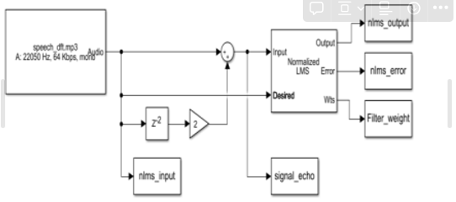
NLMS Algorithm:
One of the primary disadvantages of the LMS algorithm is having a fixed step size parameter for every iteration. In the LMS algorithm the weight adjustment is directly proportional to the amplitude of input vector samples therefore, when the vector x [n] is large, the LMS suffers from a gradient noise amplification problem. To overcome this problem, the adjustment applied to the weight vector at each iteration is normalized. The normalized least mean square algorithm (NLMS) is an extension of the LMS algorithm which bypasses this issue by calculating maximum step size µ[n]. This step size is proportional to the inverse of the total expected energy of the instantaneous values of the coefficients of the input vector x[n]. This sum of the expected energies of the input samples is also equivalent to the dot product of the input vector with itself, and the trace of input vectors auto-correlation matrix, R. In each iteration of the NLMS algorithm, the filter tap weights are updated as per Equation.

Slide 11
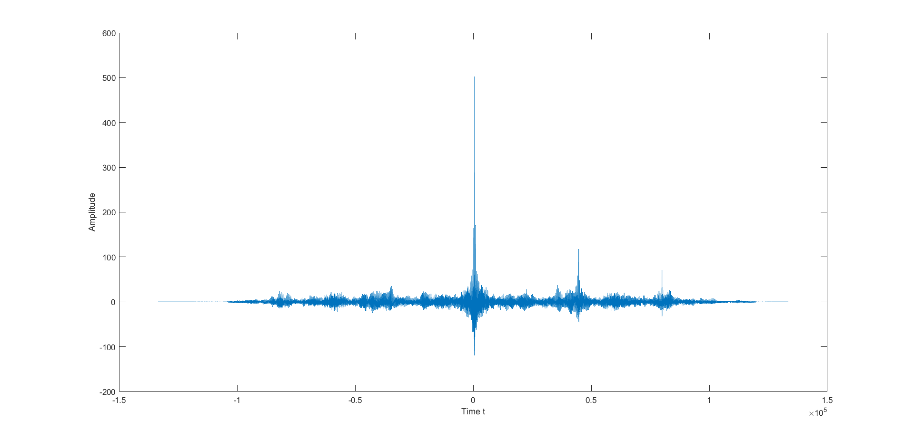
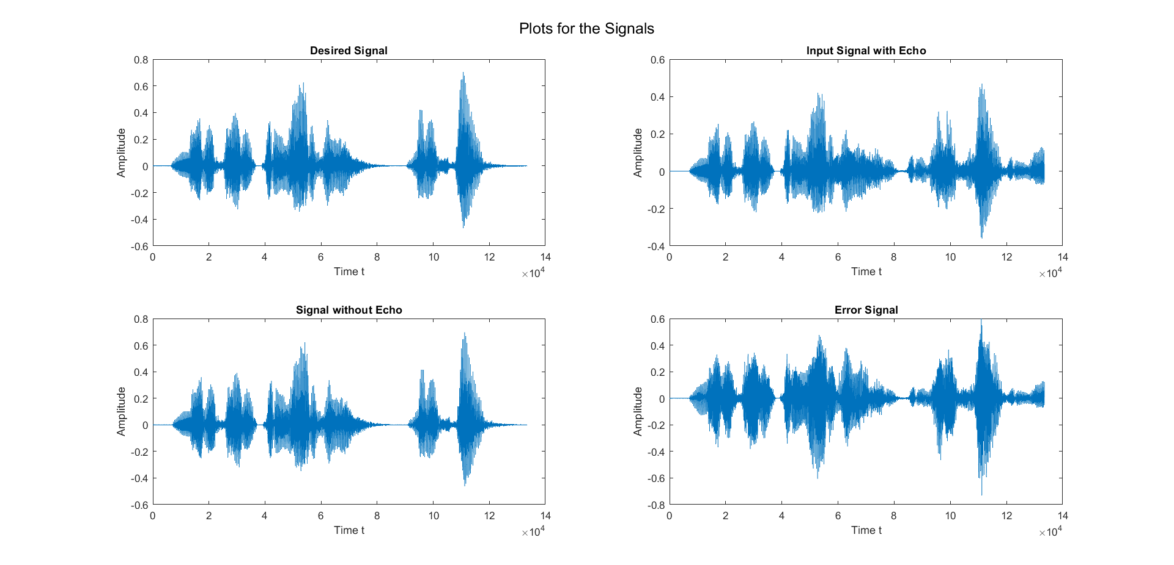
Output of Part 2:
First picture is the Cross corellation between the final output and the desired signal.
Second Picture shows all the versions of Desired Signal

Slide 12
Part 3: What is this noise?
For signals like Music, and speech we are interested in the analysis of the variation of Frequency components concerning time.
DTFT and the DFT are useful, but they both are obtained by summing the time function x[n] over a large time
So STFT is used.

Slide 13
Part 3: What is this noise?
STFT function in MATLAB generates three arrays
F, an array containing the frequency values
T, an array containing the time values
S, F X T size array containing the magnitude of Frequency Components at Given T,F.
STFT on plotting generates a 3D plot as below and also it can be translated into a 2D plot:

Slide 14
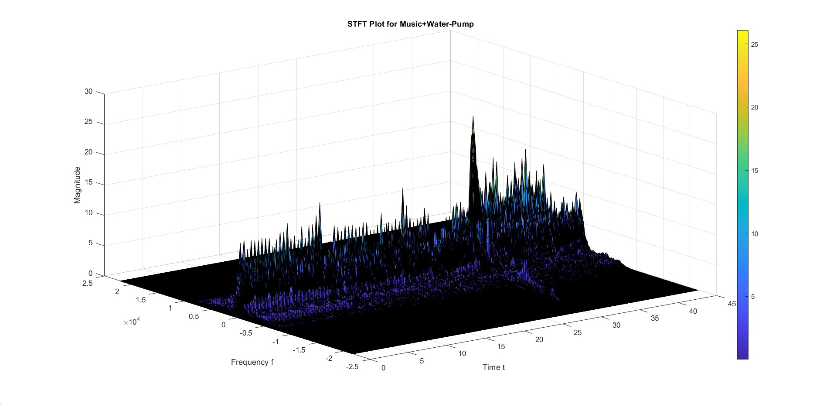
Part 3: What is this noise?

Slide 15
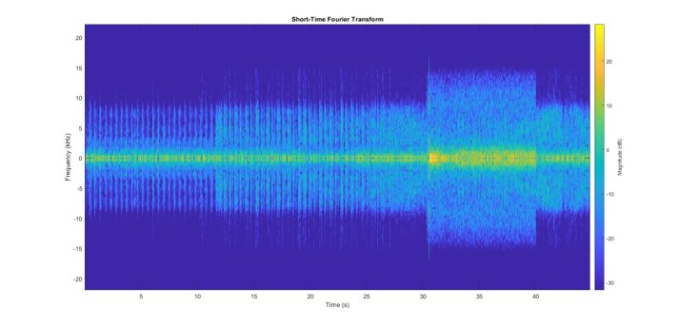
Part 3: What is this noise?

Slide 16
Part 3: What is this noise?
We add all the terms (absolute values) corresponding to a frequency at all times to create an array of size F X 1
Same Process is done to all the 3 other reference files and the Input File
RMS Error is found and the one with minimum RMS error is the noise in the given input File

Slide 17
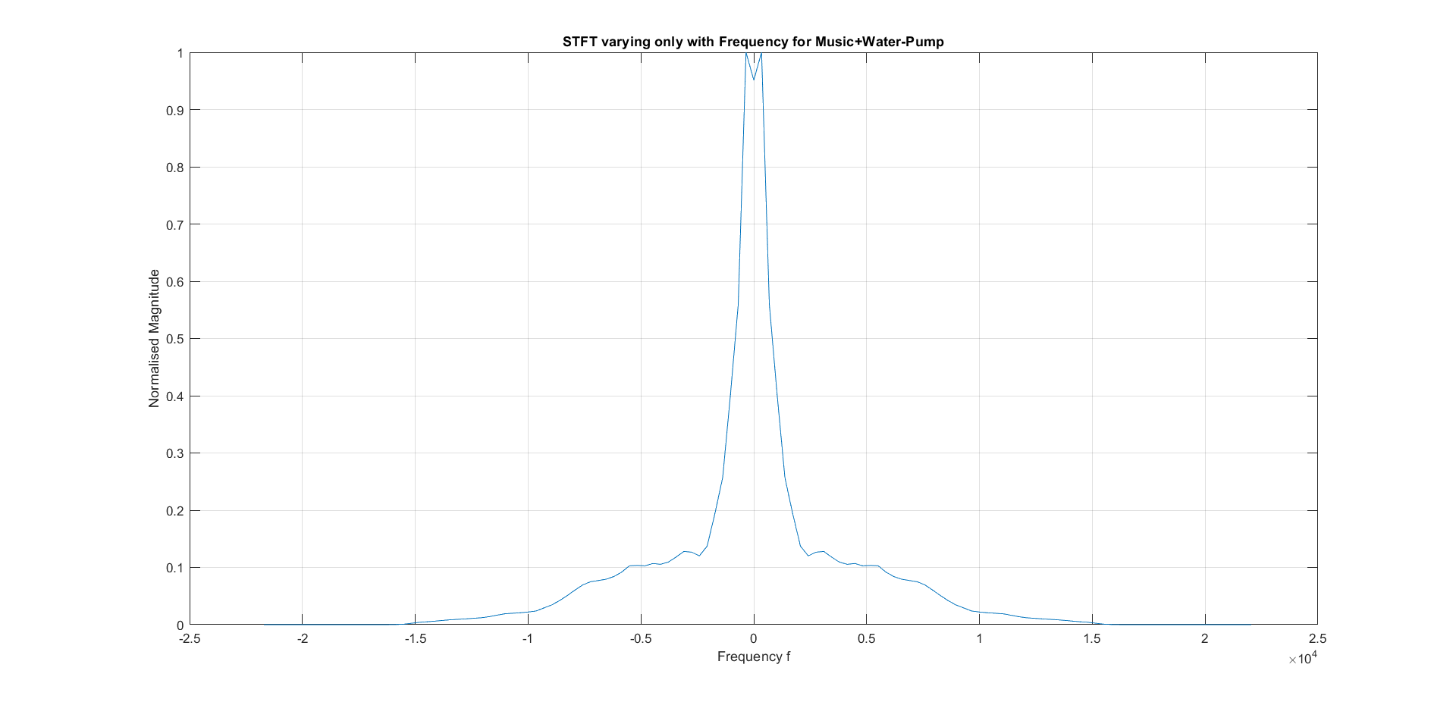
Part 3: What is this noise?

Slide 18
Done By
K Sri Rama Rathan Reddy – 2022102072
Ch Vishnu Priya – 2022102023
S Rohit - 2022102001

